Slide 1
CIS041-3 Advanced Information Technology
Web Information Retrieval 2
Link Analyze with HITS
Gangmin Li
(Office hours: 13:00-17:00 every Friday)

Slide 2
What we have learnt
Web Information retrieval in general
Web characteristics and different information seeking behaviours
Hyperlink is a extended source of information, searching based on document contents and link text performs better than text only.
Search Engine components
Web link analysis and Random walk model
Google PageRank (only considering the number of links)
We conclude with “Google PageRank needs improving!”

Slide 3
Outline
Hits - Hyperlink-Induced Topic Search
Hubs and authorities
Root set and base set

Slide 4
HITS - Hyperlink-Induced Topic Search
https://www.youtube.com/watch?v=-kiKUYM9Qq8&t=22s
Different way of define importance of a web page. By Hubs & Authorities

Slide 5
HITS - Introduction
HITS (Hyperlink-Induced Topic Search) is a link analysis algorithm that rate Web pages developed by Jon Kleinberg
There are two different types of relevance on the web.
1: Hubs. A hub page is page that pointed to many other pages [these pages answering the information need].
E.g., for query [chicago bulls]: Bob’s list of recommended resources on the Chicago Bulls sports team (page title, contents may have the query terms)
2: Authorities. An authority page is a direct answer to the information need.
The home page of the Chicago Bulls sports team
By definition: Links to authority pages occur repeatedly on hub pages.

Slide 6
HITS - Introduction
HITS (Hyperlink-Induced Topic Search) is a link analysis algorithm that rate Web pages
It was developed by Jon Kleinberg
It is used to rank the webpages relevant for a particular search.
The idea of the algorithm is originated from the fact that an ideal website should link to other relevant sites and also being linked by other important sites.
It is developed based on the two different types of relevance on the web: Hubs and Authorities.

Slide 7
Definition: Hubs and authorities
With the above observation, we will have:
A good hub page for a topic links to many authority pages for that topic. A good hub page for a topic links to many authority pages for that topic.
A good authority page for a topic is linked to by many hub pages for that topic.
Circular definition – it can be implemented by an iterative computation.

Slide 8
Example for hubs and authorities
Hubs
Authorities

Slide 9
Root set and base set
Continue our web as DAG ...
The root set (direct search results) – potential authorities
The base set (directly connected to the root set) – potential hubs
Nodes that root set nodes link to
Nodes that link to root set nodes

Slide 10
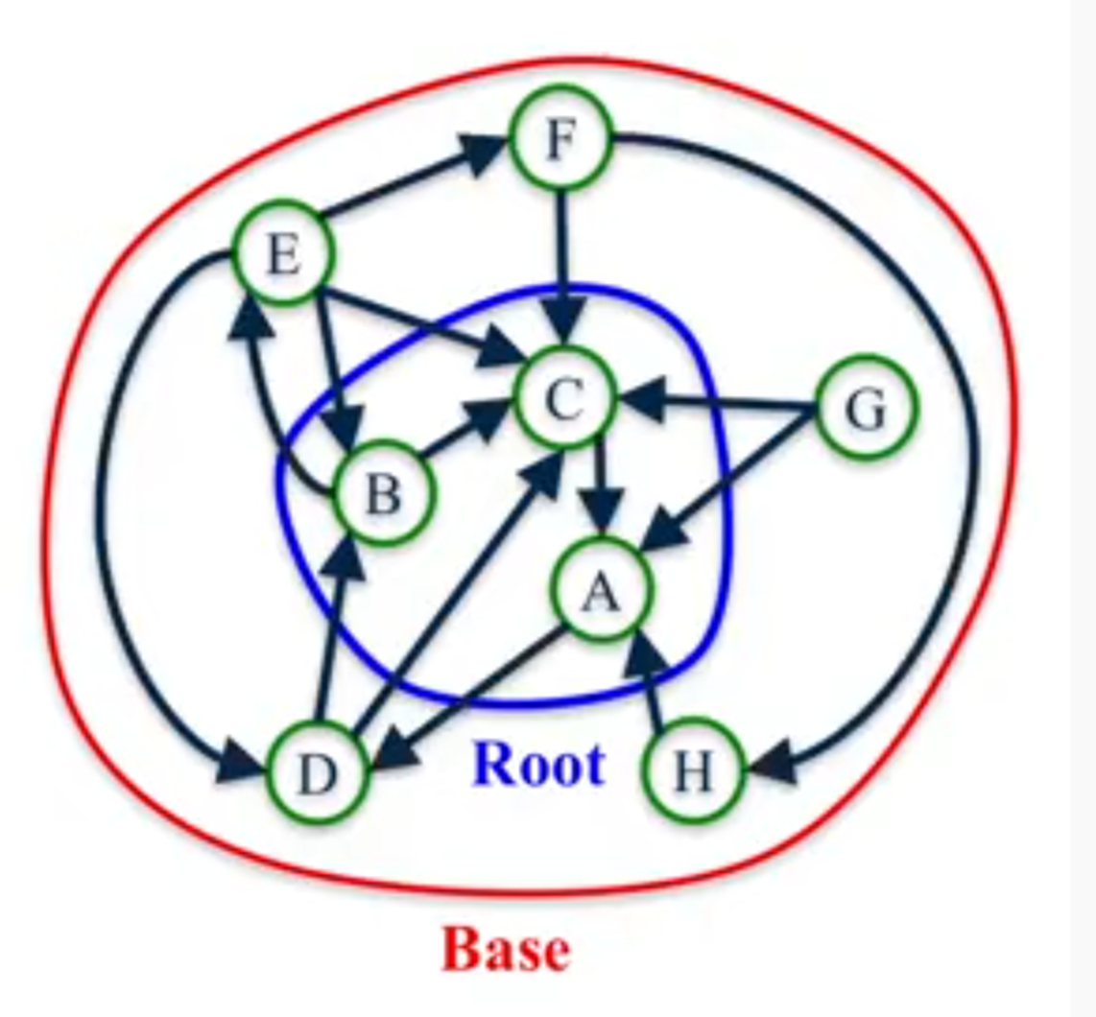
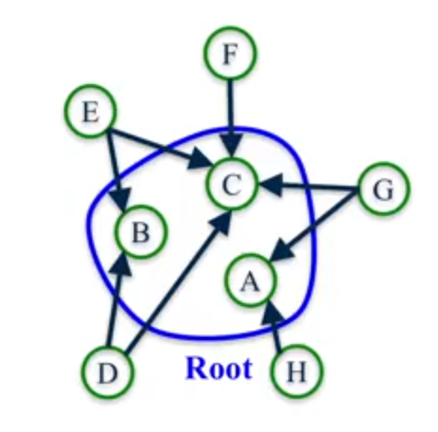
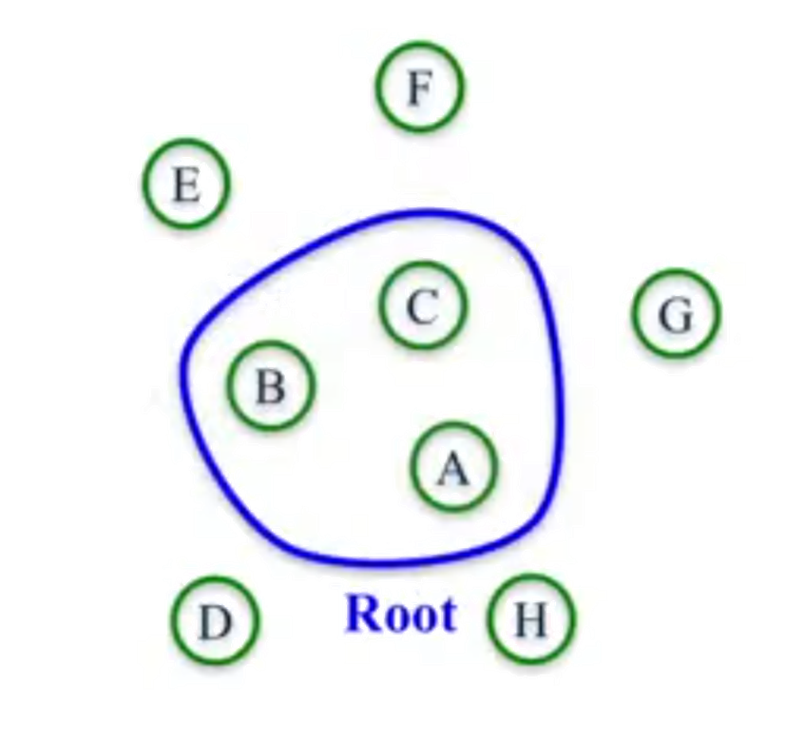
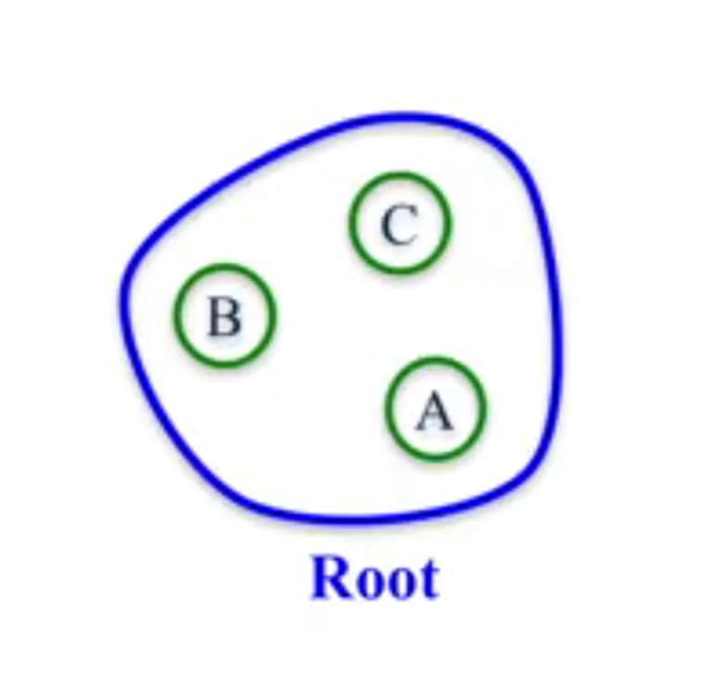
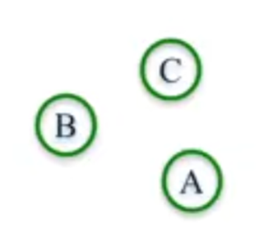
Example: Root set and base set
We have node ABC are direct return of a query,
They are potentially the authorities, so they are the Root set.
We also have node DEFGH are have links to ABC, they are potentially the Hubs, so they forms base set.

Slide 11
Typical web: Root set and base set
Root set typically has 200–1000 nodes.
Base set may have up to 5000 nodes.
We are going to consider the root set (which are the direct relevant to a query) and the base set (which are connected with the root set).
Notice that the root set and the base set together are the subset of network of webpages. (opposite with the PageRank)

Slide 12
HITS Algorithm

Slide 13
HITS Algorithm
HITS algorithm for each d to calculate hub score h(d) and authority score a(d):
Initialization: for all d: h(d) = 1, a(d) = 1
Apply the Authority Update Rule: each node’s new authority score is the sum of hub score of each node that points to it.
Apply the Hub Update Rule: each node’s new hub score is the sum of authority score of each node that points to.
Normalize Authority and Hub scores:
a(d) = $\frac{a(d)}{\sum_{i∈N}{a(i)}}$, h(d) = $\frac{h(d)}{\sum_{i∈N}{h(i)}}$
Repeat k times until convergence.
Output pages with highest h and a scores as top hubs and top authorities

Slide 14
Key of the algorithm: Iterative update

Slide 15
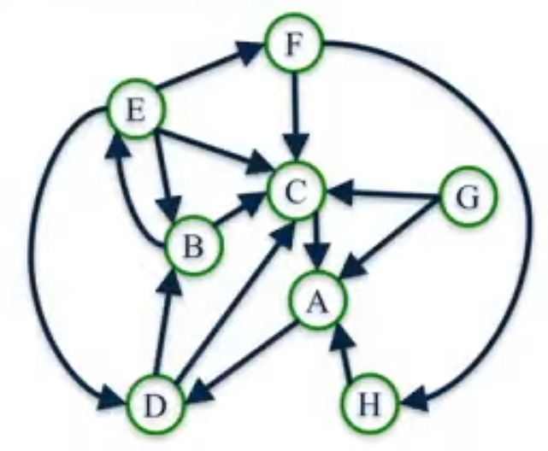
Example of HITS algorithm
Compute 2 iterations of the network.

Slide 16
HITS algorithm through an example
1. Initial all auth and Hub score to 1.
 | Old Auth | Old Hub | New Auth | New Hub
A | 1 | 1
B | 1 | 1
C | 1 | 1
D | 1 | 1
E | 1 | 1
F | 1 | 1
G | 1 | 1
H | 1 | 1

Slide 17
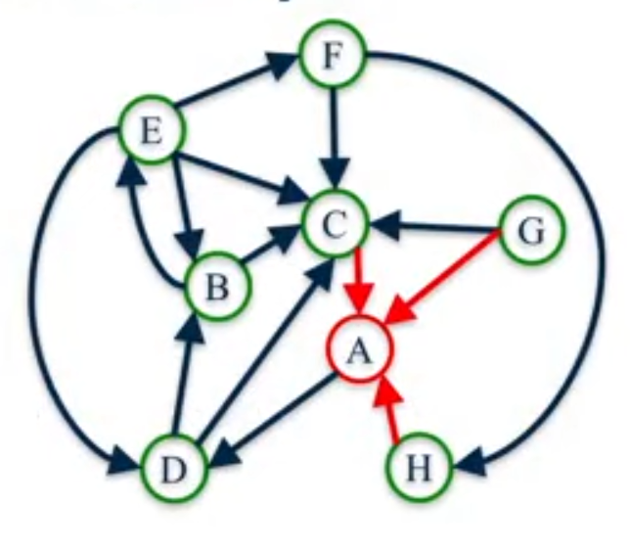
Example of HITS algorithm
 | Old Auth | Old Hub | New Auth | New Hub
A | 1 | 1 | 3
B | 1 | 1
C | 1 | 1
D | 1 | 1
E | 1 | 1
F | 1 | 1
G | 1 | 1
H | 1 | 1
2. Compute new auth score of A
The sum of hub score of each node that points to it

Slide 18
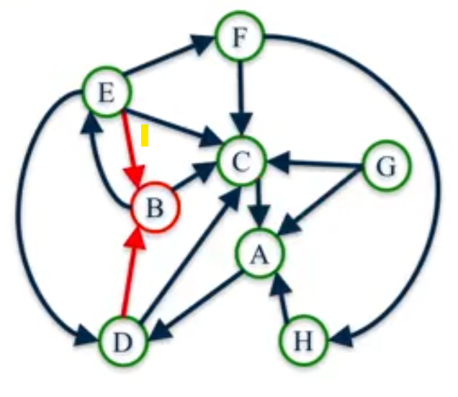
Example of HITS algorithm
 | Old Auth | Old Hub | New Auth | New Hub
A | 1 | 1 | 3
B | 1 | 1 | 2
C | 1 | 1
D | 1 | 1
E | 1 | 1
F | 1 | 1
G | 1 | 1
H | 1 | 1
Compute new auth score of B

Slide 19
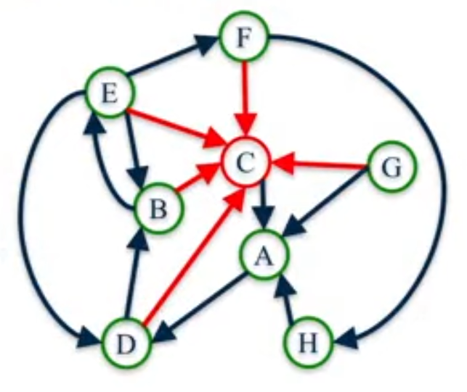
Example of HITS algorithm
 | Old Auth | Old Hub | New Auth | New Hub
A | 1 | 1 | 3
B | 1 | 1 | 2
C | 1 | 1 | 5
D | 1 | 1
E | 1 | 1
F | 1 | 1
G | 1 | 1
H | 1 | 1
Compute new auth score of C

Slide 20
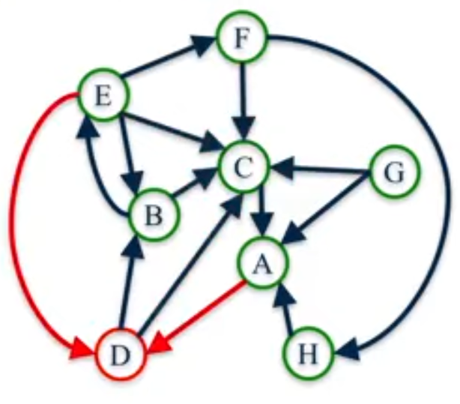
Example of HITS algorithm
 | Old Auth | Old Hub | New Auth | New Hub
A | 1 | 1 | 3
B | 1 | 1 | 2
C | 1 | 1 | 5
D | 1 | 1 | 2
E | 1 | 1
F | 1 | 1
G | 1 | 1
H | 1 | 1
Compute new auth score of D

Slide 21
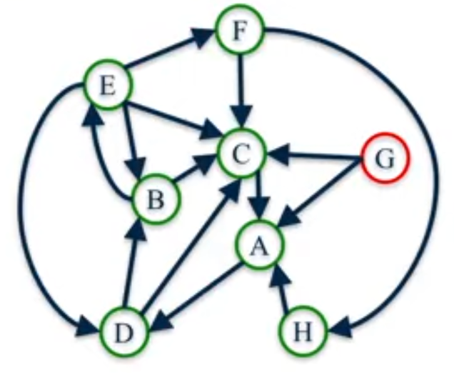
Example of HITS algorithm
 | Old Auth | Old Hub | New Auth | New Hub
A | 1 | 1 | 3
B | 1 | 1 | 2
C | 1 | 1 | 5
D | 1 | 1 | 2
E | 1 | 1 | 1
F | 1 | 1 | 1
G | 1 | 1 | 0
H | 1 | 1 | 1
Compute new auth score of G

Slide 22
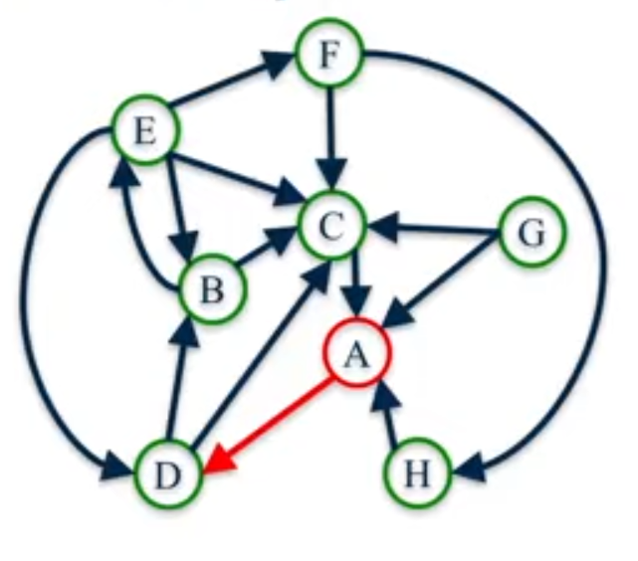
Example of HITS algorithm
 | Old Auth | Old Hub | New Auth | New Hub
A | 1 | 1 | 3 | 1
B | 1 | 1 | 2
C | 1 | 1 | 5
D | 1 | 1 | 2
E | 1 | 1 | 1
F | 1 | 1 | 1
G | 1 | 1 | 0
H | 1 | 1 | 1
3. Compute new hub score of A
The sum of authority score of each node that points to

Slide 23
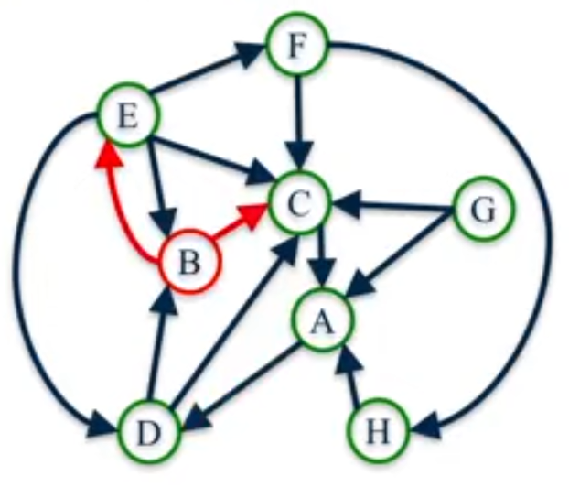
Example of HITS algorithm
 | Old Auth | Old Hub | New Auth | New Hub
A | 1 | 1 | 3 | 1
B | 1 | 1 | 2 | 2
C | 1 | 1 | 5
D | 1 | 1 | 2
E | 1 | 1 | 1
F | 1 | 1 | 1
G | 1 | 1 | 0
H | 1 | 1 | 1
Compute new hub score of B

Slide 24
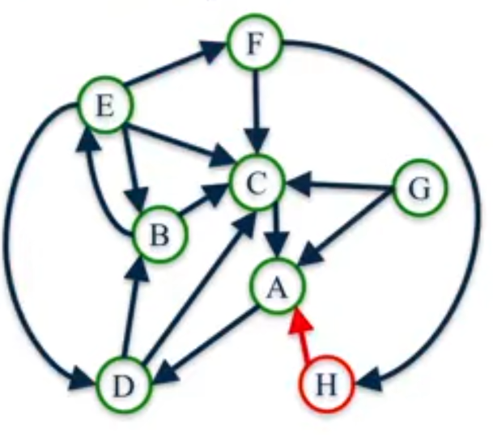
Example of HITS algorithm
 | Old Auth | Old Hub | New Auth | New Hub
A | 1 | 1 | 3 | 1
B | 1 | 1 | 2 | 2
C | 1 | 1 | 5 | 1
D | 1 | 1 | 2 | 2
E | 1 | 1 | 1 | 4
F | 1 | 1 | 1 | 2
G | 1 | 1 | 0 | 2
H | 1 | 1 | 1 | 1
Compute new hub score of H

Slide 25
Example of HITS algorithm
 | Old Auth | Old Hub | New Auth | New Hub
A | 1 | 1 | 3 | 1
B | 1 | 1 | 2 | 2
C | 1 | 1 | 5 | 1
D | 1 | 1 | 2 | 2
E | 1 | 1 | 1 | 4
F | 1 | 1 | 1 | 2
G | 1 | 1 | 0 | 2
H | 1 | 1 | 1 | 1
Normalize:
$$\sum_{i∈N}{a\left(i\right)=15},\sum_{i∈N}{h\left(i\right)=15}$$

Slide 26
Example of HITS algorithm
 | Old Auth | Old Hub | New Auth | New Hub
A | 1 | 1 | 3/15 | 1/15
B | 1 | 1 | 2/15 | 2/15
C | 1 | 1 | 5/15 | 1/15
D | 1 | 1 | 2/15 | 2/15
E | 1 | 1 | 1/15 | 4/15
F | 1 | 1 | 1/15 | 2/15
G | 1 | 1 | 0/15 | 2/15
H | 1 | 1 | 1/15 | 1/15
4. Normalize:
$$\sum_{i∈N}{a\left(i\right)=15},\sum_{i∈N}{h\left(i\right)=15}$$

Slide 27
2nd Iteration
 | Old Auth | Old Hub | New Auth | New Hub
A | 1/5 | 1/15
B | 2/15 | 2/15
C | 1/3 | 1/15
D | 2/15 | 2/15
E | 1/15 | 4/15
F | 1/15 | 2/15
G | 0 | 2/15
H | 1/15 | 1/15
Next iteration: New score => Old score

Slide 28
Example of HITS algorithm
 | Old Auth | Old Hub | New Auth | New Hub
A | 1/5 | 1/15 | 4/15
B | 2/15 | 2/15
C | 1/3 | 1/15
D | 2/15 | 2/15
E | 1/15 | 4/15
F | 1/15 | 2/15
G | 0 | 2/15
H | 1/15 | 1/15
Compute new auth score of A

Slide 29
Example of HITS algorithm
 | Old Auth | Old Hub | New Auth | New Hub
A | 1/3 | 1/15 | 4/15
B | 2/15 | 2/15 | 6/15
C | 1/3 | 1/15
D | 2/15 | 2/15
E | 1/15 | 4/15
F | 1/15 | 2/15
G | 0 | 2/15
H | 1/15 | 1/15
Compute new auth score of B

Slide 30
Example of HITS algorithm
 | Old Auth | Old Hub | New Auth | New Hub
A | 1/5 | 1/15 | 4/15
B | 2/15 | 2/15 | 6/15
C | 1/3 | 1/15 | 12/15
D | 2/15 | 2/15
E | 1/15 | 4/15
F | 1/15 | 2/15
G | 0 | 2/15
H | 1/15 | 1/15
Compute new auth score of C

Slide 31
Example of HITS algorithm
 | Old Auth | Old Hub | New Auth | New Hub
A | 1/5 | 1/15 | 4/15
B | 2/15 | 2/15 | 6/15
C | 1/3 | 1/15 | 12/15
D | 2/15 | 2/15 | 1/3
E | 1/15 | 4/15 | 2/15
F | 1/15 | 2/15 | 4/15
G | 0 | 2/15 | 0
H | 1/15 | 1/15 | 2/15
Repeat for all other notes

Slide 32
Computer all the new hub score
 | Old Auth | Old Hub | New Auth | New Hub
A | 1/5 | 1/15 | 4/15 | 2/15
B | 2/15 | 2/15 | 6/15
C | 1/3 | 1/15 | 12/15
D | 2/15 | 2/15 | 1/3
E | 1/15 | 4/15 | 2/15
F | 1/15 | 2/15 | 4/15
G | 0 | 2/15 | 0
H | 1/15 | 1/15 | 2/15
Compute node A’s new Hub score using old Auth score

Slide 33
Computer all the new hub score
 | Old Auth | Old Hub | New Auth | New Hub
A | 1/5 | 1/15 | 4/15 | 2/15
B | 2/15 | 2/15 | 6/15 | 2/5
C | 1/3 | 1/15 | 12/15
D | 2/15 | 2/15 | 1/3
E | 1/15 | 4/15 | 2/15
F | 1/15 | 2/15 | 4/15
G | 0 | 2/15 | 0
H | 1/15 | 1/15 | 2/15
Compute node B’s new Hub score using old Auth score

Slide 34
Computer all the new hub score
 | Old Auth | Old Hub | New Auth | New Hub
A | 1/5 | 1/15 | 4/15 | 2/15
B | 2/15 | 2/15 | 6/15 | 2/5
C | 1/3 | 1/15 | 12/15 | 1/5
D | 2/15 | 2/15 | 1/3 | 7/15
E | 1/15 | 4/15 | 2/15 | 2/3
F | 1/15 | 2/15 | 4/15 | 2/5
G | 0 | 2/15 | 0 | 8/15
H | 1/15 | 1/15 | 2/15 | 1/5
Repeat for all other notes.

Slide 35
Normalize a(i)
 | Old Auth | Old Hub | New Auth | New Hub
A | 1/5 | 1/15 | 4/15 | 2/15
B | 2/15 | 2/15 | 6/15 | 2/5
C | 1/3 | 1/15 | 12/15 | 1/5
D | 2/15 | 2/15 | 1/3 | 7/15
E | 1/15 | 4/15 | 2/15 | 2/3
F | 1/15 | 2/15 | 4/15 | 2/5
G | 0 | 2/15 | 0 | 8/15
H | 1/15 | 1/15 | 2/15 | 1/5
Normalize:$\sum_{i∈N}{a(i)}={35}/{15}$

Slide 36
Update all new a(i)=a(i)/ $\sum_{i∈N}{a(i)}$
 | Old Auth | Old Hub | New Auth | New Hub
A | 1/5 | 1/15 | 4/35 | 2/15
B | 2/15 | 2/15 | 6/35 | 2/5
C | 1/3 | 1/15 | 12/35 | 1/5
D | 2/15 | 2/15 | 1/7 | 7/15
E | 1/15 | 4/15 | 2/35 | 2/3
F | 1/15 | 2/15 | 4/35 | 2/5
G | 0 | 2/15 | 0 | 8/15
H | 1/15 | 1/15 | 2/35 | 1/5
$a\left(i\right)=a\left(i\right)/{35}/{15}$

Slide 37
Normalize h(i)
 | Old Auth | Old Hub | New Auth | New Hub
A | 1/5 | 1/15 | 4/15 | 2/15
B | 2/15 | 2/15 | 6/15 | 2/5
C | 1/3 | 1/15 | 12/15 | 1/5
D | 2/15 | 2/15 | 1/3 | 7/15
E | 1/15 | 4/15 | 2/15 | 2/3
F | 1/15 | 2/15 | 4/15 | 2/5
G | 0 | 2/15 | 0 | 8/15
H | 1/15 | 1/15 | 2/15 | 1/5
Normalize:
$\sum_{i∈N}{h(i)}={45}/{15}=3$

Slide 38
Update all new h(i)=h(i)/ $\sum_{i∈N}{h(i)}$
 | Old Auth | Old Hub | New Auth | New Hub
A | 1/5 | 1/15 | 4/35 | 2/45
B | 2/15 | 2/15 | 6/35 | 2/15
C | 1/3 | 1/15 | 12/35 | 1/15
D | 2/15 | 2/15 | 1/7 | 7/45
E | 1/15 | 4/15 | 2/35 | 2/9
F | 1/15 | 2/15 | 4/35 | 2/15
G | 0 | 2/15 | 0 | 8/45
H | 1/15 | 1/15 | 2/35 | 1/15

Slide 39
Repeat the process to 6 iterations
Some score continue changing

Slide 40
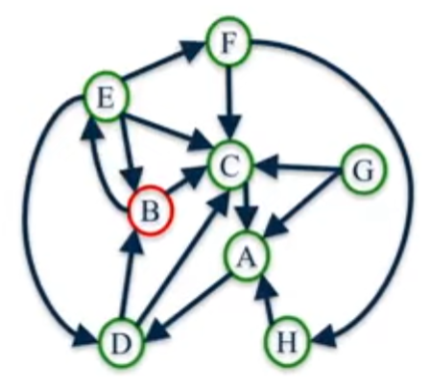
Continue iterations…..
Node B

Slide 41
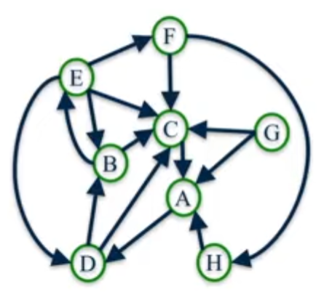
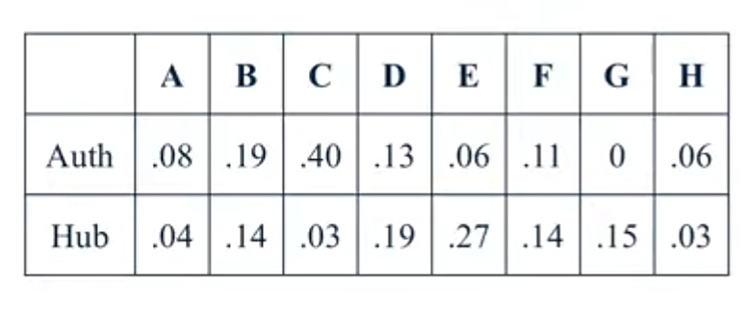
HITS Algorithms Convergence
For most networks, as k gets larger, authority and hub scores converge to a unique value.
As k $\overset{→}{}∞,$the hub and authority scores approach:

Slide 42
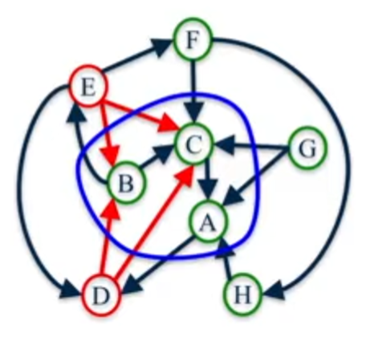
Conclusion & interpretation
Nodes have the highest authority score are B and C
Nodes have the highest hub score are D and E
B and C are the root nodes
D and E are good hub nodes since they points to B and C

Slide 43
Python lib
HITS Algorithm available on NetworkX (https://networkx.org/)
You can use NetworkX function hits(G) to compute the hub and authority scores of network G.
Hits(G) outputs two dictionaries, keyed by node, with the hub and authority scores of the nodes.

Slide 44
PageRank vs. HITS: Discussion
PageRank can be precomputed, HITS has to be computed at query time.
HITS is too expensive in most application scenarios.
PageRank and HITS make two different design choices concerning (i) the eigenproblem formalisation (ii) the set of pages to apply the formalisation to.
These two are orthogonal. We could also apply HITS to the entire web and PageRank to a small base set.
Claim: On the web, a good hub almost always is also a good authority.
The actual difference between PageRank ranking and HITS ranking is therefore not as large as one might expect.

Slide 45
Reading
Book Chapter 21 Link analysis.
Jon M. Kleinberg (1998) “Authoritative Sources in a Hyperlinked Environment∗”.
Both are available on BREO

